Slide 1
LEOLANI
A Knowledge-Graph-
Driven Chat Agent
Grounding a lifestyle-coaching conversation in a living knowledge graph — architecture, conversational strategies, and a live example.
Piek Vossen — Vrije Universiteit Amsterdam
cltl-kg-driven-chat
Type 2 diabetes self-management
Notes:
Welcome. This deck walks through how the agent is put together, the conversational strategies it uses to decide what to ask, and a live example with Jan.

Slide 2
WHY THIS AGENT EXISTS
A coach that remembers, not just a chatbot that replies
Structured diary construction
The graph drives the dialogue
Built for Type 2 diabetes
Every turn is turned into semantic-role triples and pushed into a knowledge graph — a persistent, queryable record of what the person actually did and felt.
What's still missing in the graph — not a fixed script — decides the agent's next question, so the conversation stays grounded in this person's own history.
Diet, exercise, sleep, mood, medication and symptoms — everyday factors that shape blood-sugar management, tracked over time, not just one session.
Building on structured-diary and synthetic-dialogue work for functioning & well-being monitoring — see References.
Leolani — Knowledge-Graph-Driven Chat Agent
2 / 15

Slide 3


HIGH-LEVEL ARCHITECTURE
Two pipelines, one shared graph
Human turn
SRL extraction
Knowledge graph
Gap finding
Agent turn
What the person says this turn
events_from_chat/ — an LLM tags agent, patient, time, location, qualification
GraphDB — n2mu role predicates, SEM-ontology aligned
chat_from_kg/ — what's still missing for this activity?
A natural-language follow-up question
Repeats every turn — the graph accumulates across the whole conversation, not just one exchange.
chat_sessions.py
kg_chat_gui.py
catch_up_from_kg.py
Orchestrates every turn — ChatSession → KgChatSession → KgIntentChatSession
Chat window plus a live node-link graph panel
The saturation loop that opens and paces a session
Leolani — Knowledge-Graph-Driven Chat Agent
3 / 15

Slide 4
PIPELINE ONE
From a sentence to graph triples
JAN SAYS
"I cycled for an hour yesterday"
Incremental, not batch — one LLM call per turn keeps the running history, so "it" and "that" still resolve to the right earlier activity.
One id per real-world event — the same activity_id is reused every time it's mentioned again, even with no new phrase.
Pronouns become identities — "I" and "you" link to a real person's URI, not a bare, unlinked word.
One shared role vocabulary — agent, patient, location, time, qualification — under the project's own n2mu: namespace.
agent_patient
Jan
time
yesterday
qualification
for an hour
Leolani — Knowledge-Graph-Driven Chat Agent
4 / 15

Slide 5

GROUNDED IN REAL CONVERSATIONAL DATA
256 synthetic conversations, one lifestyle coach
256
2,003
2,656
3,506
1,047
conversations
annotated turns
unique activities
output entries
time expressions — 842 resolved
What's annotated, per turn
Activity and condition mentions, typed (diet, exercise, treatment, symptom …) with a stable id reused across turns
Top activity types, by share
Diet
25%
Semantic roles — agent, patient, agent_patient, experiencer, instrument, result, location, time
Exercise
17%
Physical condition
12%
Other
8%
Time expressions resolved to point, range, duration, recurring or vague
Treatment
7%
Measurement
6%
Speaker perspective per turn — emotion, factuality, certainty
ChatGPT-generated chats across 16 fake diabetes patients (age, gender, ethnicity, biography), randomly grounded January 2010 – June 2015 (Ntanavaras, de Boer & Vossen, 2026 — see References).
Leolani — Knowledge-Graph-Driven Chat Agent
5 / 15

Slide 6
THE CORPUS BECOMES A MEMORY
An event-centric knowledge graph, not a transcript
JAN SAYS
Every mention is an EventSeries instance — not a flat triple. The same identifier is reused every time thirst comes up again, exactly like activity_id in this agent's own graph.
"I'm concerned about my frequent thirst and dry mouth."
thirst_and_dry_mouth_1
Perspective travels with the event — attributedTo links it to an attribution node carrying the speaker's emotion, factuality and certainty. A memory, not just a fact.
instanceOf
EventSeries
experiencer
Jan
time
frequent
One shared role set — agent, patient, agent_patient, experiencer, instrument, location, time, result — the same vocabulary this agent's own n2mu roles build on.
attributedTo → emotion
fear
Distinct entities extracted from the corpus, by type
432
359
274
221
216
62
58
activities
objects
instruments
properties
time expr.
agents
places
Leolani — Knowledge-Graph-Driven Chat Agent
6 / 15

Slide 7
CONVERSATIONAL STRATEGY — DECIDING WHAT'S MISSING
Two ways to spot a knowledge gap
KG_GAP_FINDER.PY
INTENT_GAP_FINDER.PY
Peer statistics
Hand-authored intents
Compares an activity to similar past instances. A gap fires once a majority of peers share the missing predicate.
One JSON file per topic — diet, exercise, sleep, symptoms, medication, conditions, measurements — each stating what a complete record needs.
Limit: the very first instance of a kind has no peers yet — no gap can ever fire for it.
Works from the very first mention — the expectation is declared, not inferred from peers.
Same per-turn loop either way — KgChatSession vs. KgIntentChatSession swap only the gap-finding step.
Leolani — Knowledge-Graph-Driven Chat Agent
7 / 15

Slide 8

CONVERSATIONAL STRATEGY — ONE INTENT, IN ORDER
Ask one thing at a time, in priority order
1 · What
2 · How much / long
3 · When
4 · Extra detail
patient_type
qualification
activity_date
secondary objectives
What was eaten, drunk, taken or measured
Duration, degree, quantity — only once step 1 is known
Any time value at all — only once 1 and 2 are filled
Only reached once 1–3 are all satisfied
measurement_intents.json, in practice
"Did you measure blood sugar level lately?" → "What did you measure?" (quantity) → "When did you measure it?" — each question only paraphrases the intent's own hand-written template, so a weaker model never leaks a raw role name like "patient" into the question.
Leolani — Knowledge-Graph-Driven Chat Agent
8 / 15

Slide 9



CONVERSATIONAL STRATEGY — GETTING THE ANSWER TO STICK
Capture the answer, don't lose it to a coreference miss
Confirm, don't interrogate
Attach the reply directly
Never ask forever
A missing "who" is asked as "Was that you?" — not an open question. Yes / no / a correction is pushed straight to the graph.
A single-predicate gap arms a pending slot. The next reply is classified ANSWER / DECLINE / UNRELATED and written straight onto that same activity — never left for the extractor to re-link.
Two backstops: a gap already asked is never repeated, and a requirement gets a fixed number of tries across the whole chat before the agent moves on.
Why it matters: a short reply like "30 minutes" often gets coreferenced onto a brand-new, empty subject — direct capture skips that guesswork entirely.
Leolani — Knowledge-Graph-Driven Chat Agent
9 / 15

Slide 10
CONVERSATIONAL STRATEGY — OPENING A SESSION
Ask until there's enough — not just once
rest of this person's history
last 14 days
sets the weekly baseline per topic
the catch-up window, even if the real gap is longer
1
2
3
Weekly baseline, per topic
Ask, biggest shortfall first
Enough? Let the LLM decide
"3 exercise sessions per week, historically" — from this person's own dated past, tiled in 7-day windows
One topic at a time; a repeat is reworded as "anything else...", never the identical question
Continue naturally if there's a thread left, or wrap up and say goodbye — reading the human's own last message, not just the tally
Ask "what did we discuss?" any time — a plain recap of what's covered vs. still open, with no effect on the loop itself.
Leolani — Knowledge-Graph-Driven Chat Agent
10 / 15

Slide 11
CONVERSATIONAL STRATEGY — NEVER A DEAD END
An acknowledgement is never the whole reply
BEFORE
AFTER
"Thanks for letting me know."
"No worries, thanks for letting me know. How has your exercise been going lately?"
Same acknowledgement — immediately chained into the next open topic.
The reply, and the conversation, just stop there.
Every acknowledgement now calls straight into the agent's own reply function afterward — the exact call the conversation would make anyway once nothing else is pending, made explicit so it always fires.
Leolani — Knowledge-Graph-Driven Chat Agent
11 / 15

Slide 12
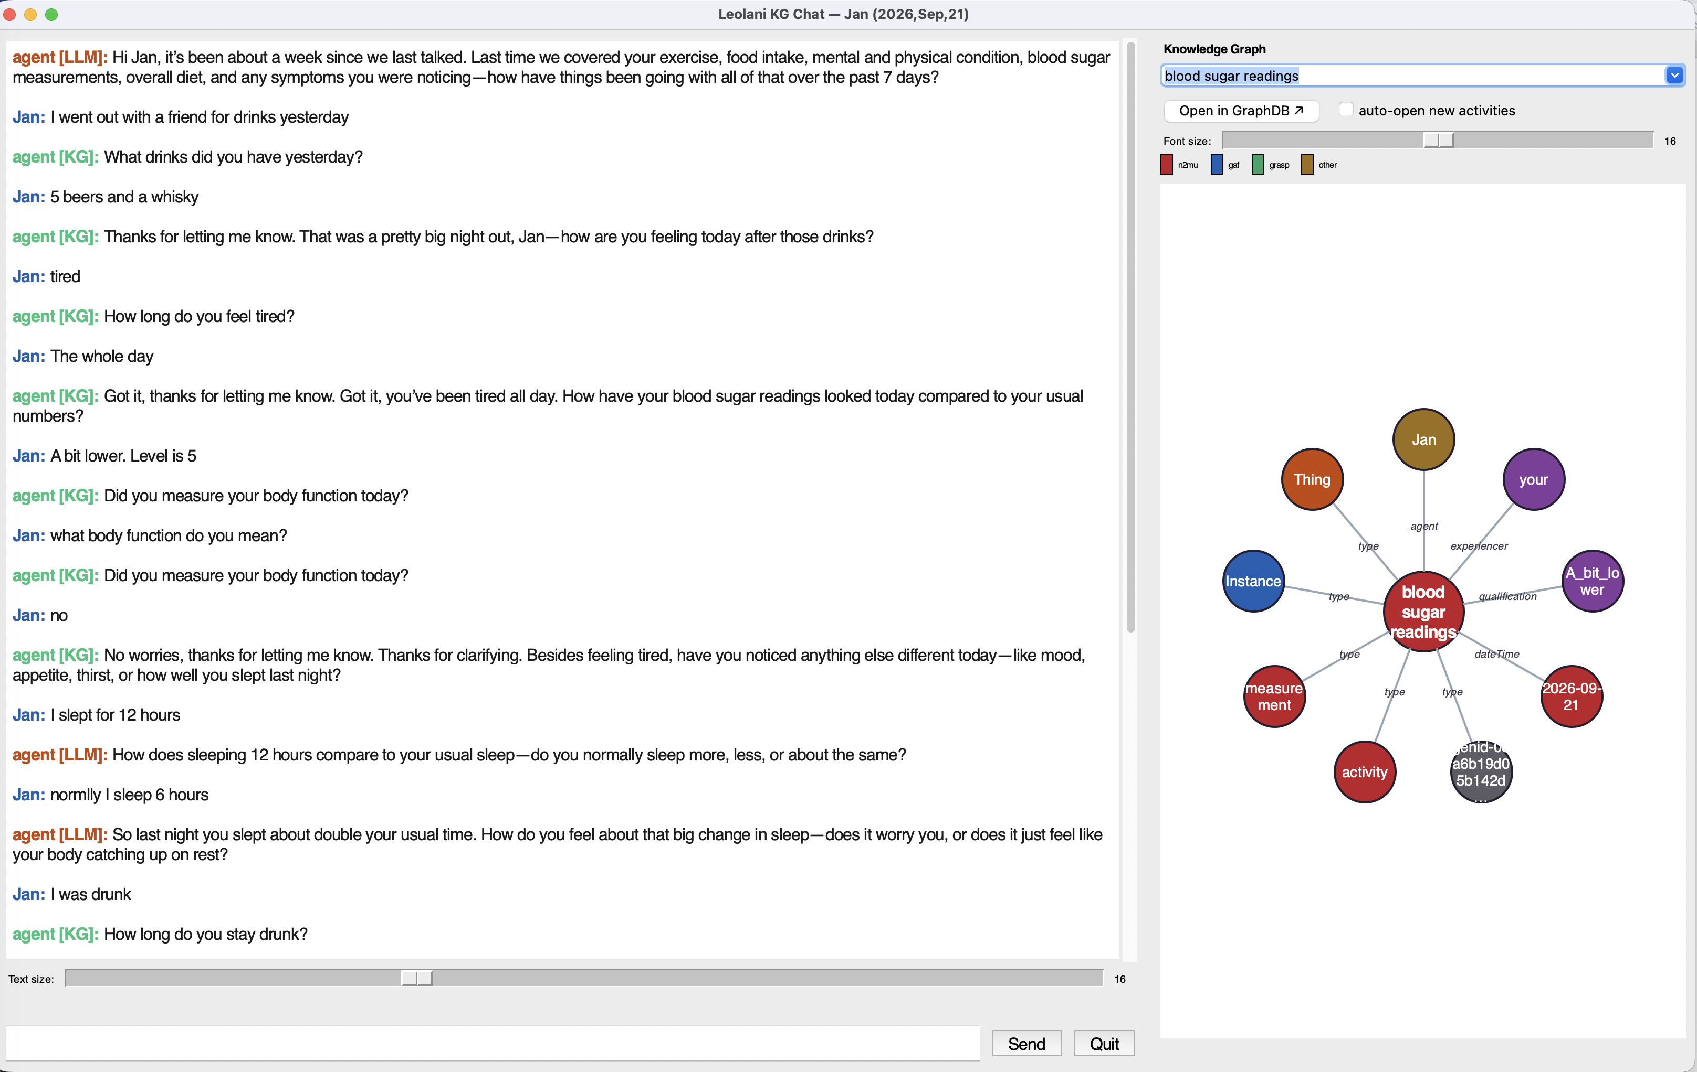
A LIVE EXAMPLE — OVERVIEW
Catching up with Jan
Opens with a recap
Names last time's topics, then asks one specific question to start
Follow-ups drill down
Drinks, duration, blood sugar — one intent question at a time
The graph, live
Every fact lands on the right — here, "blood sugar readings" grounded by agent, qualification and date
The screenshot is hard to read at a distance — full, readable transcript on the next slide →
Leolani — Knowledge-Graph-Driven Chat Agent
12 / 15

Slide 13
A LIVE EXAMPLE — THE TRANSCRIPT
Same conversation, read in full
LLM
the general reply — opening recap, pacing, or plain conversation
KG
a knowledge-graph gap — one specific missing fact about what was just reported
LLM
"It's been about a week — last time we covered exercise, food, mood, blood sugar and more. How have things been this past week?"
Jan
"I went out with a friend for drinks yesterday"
KG
"What drinks did you have yesterday?"
Jan
"5 beers and a whisky"
KG
"Thanks for letting me know — how are you feeling today after those drinks?"
Jan
"tired"
KG
"How long do you feel tired?"
Jan
"The whole day"
KG turns chain directly off what Jan just said, one missing fact at a time; the LLM turn paces the whole session against the graph's own history.
Leolani — Knowledge-Graph-Driven Chat Agent
13 / 15

Slide 14


GROUNDING, MADE VISIBLE
A live graph panel, next to the chat
Colored by namespace
Red for the project's own n2mu roles, blue/green for the shared GAF and GRASP ontologies, gold for anything else
Jan
a bit lower
agent
qualification
blood sugar readings
No provenance clutter
The label predicate and pure extraction-provenance links are never drawn as their own nodes
type
dateTime
measure
today
Duplicate edges merged
An inferred sem:hasActor copy collapses onto the real n2mu:agent edge that already points at the same object
Leolani — Knowledge-Graph-Driven Chat Agent
14 / 15

Slide 15
TAKEAWAYS
Grounded, paced, and never a dead end
The graph — not a script — decides the next question, from the very first mention of a topic.
REFERENCES
Sessions open by measuring the real gap against this person's own history, then ask until there's genuinely enough.
Vossen, P., Báez Santamaría, S., & Baier, T. (2024). A conversational agent for structured diary construction enabling monitoring of functioning & well-being. HHAI 2024: Proceedings of the Third International Conference on Hybrid Human-Artificial Intelligence (pp. 315–324). SAGE Publications.
Answers are captured directly and never asked for twice; acknowledgements always keep the conversation moving.
Every fact is visible, live, in a graph panel colored and de-duplicated for a human to actually read.
Ntanavaras, S., de Boer, M., & Vossen, P. (2026). A synthetic conversational dataset for Type 2 diabetes management. Proceedings of the Third Workshop on Patient-Oriented Language Processing (CL4Health) @ LREC 2026 (pp. 171–181).
Reconstructing lifestyles from conversations between Diabetes patients and a coach. LREC 2026 (under review) — the conversational corpus and event-centric knowledge graph behind this agent's memory.
Leolani — Knowledge-Graph-Driven Chat Agent
15 / 15

